Slide 1
Ready-to-go Lesson Slides
Year 3
Fractions
Lesson 7
Spr5

Slide 3
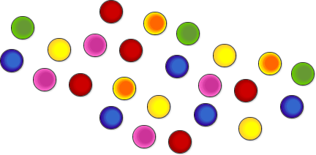
STARTER:
You have 48 counters.
You can divide them into equal groups of any size, as long as all the groups are equal.
How many different ways of doing this are there?

Slide 4
STARTER:
You have 48 counters.
You can divide them into equal groups of any size, as long as all the groups are equal.
How many different ways of doing this are there?
Groups of 48 (1 group)
Groups of 24 (2 groups)
Groups of 16 (3 groups)
Groups of 12 (4 groups)
Groups of 8 (6 groups)
Groups of 6 (8 groups)
Groups of 4 (12 groups)
Groups of 3 (16 groups)
Groups of 2 (24 groups)
Groups of 1 (48 groups)

Slide 5
TALKING TIME:
1
6
Find of 12 tennis balls by completing the sentences below.
To find one sixth, we can divide the amount into ___ equal groups.
There are ___ tennis balls in each group.
of 12 is equal to ___.
1
6

Slide 6
TALKING TIME:
1
6
Find of 12 tennis balls by completing the sentences below.
To find one sixth, we can divide the amount into 6 equal groups.
There are 2 tennis balls in each group.
of 12 is equal to 2 .
1
6

Slide 7
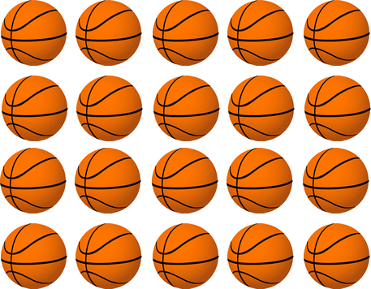
TALKING TIME:
1
5
Find of 20 basketballs.
To find one fifth, we need to divide the amount into ___ equal groups.
There are __ basketballs in each group.
of 20 is equal to ___ because 20 ÷ 5 = ___.
1
5

Slide 8
TALKING TIME:
1
5
Find of 20 basketballs.
To find one fifth, we need to divide the amount into 5 equal groups.
There are 4 basketballs in each group.
of 20 is equal to 4 because 20 ÷ 5 = 4 .
1
5

Slide 9
ACTIVITY 1:
1
3
Use counters to find of 24.
How many counters will you need?
How many equal groups will you need to divide them into?
How many are in each group?
Can you write the calculation as a number sentence?

Slide 10
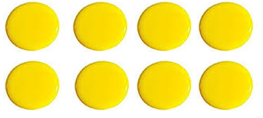
ACTIVITY 1:
1
3
Use counters to find of 24.
24 ÷ 3 = 8
24 divided into 3 equal groups = 8 in each group.
So, of 24 is 8.
1
3

Slide 11
ACTIVITY 2:
Class 3 are calculating fractions of amounts.
They work out these division calculations.
What fractions are they working out?
48 ÷ 4 60 ÷ 5
54 ÷ 2 18 ÷ 6
18 ÷ 3 40 ÷ 10

Slide 12
ACTIVITY 2:
Class 3 are calculating fractions of amounts.
They work out these division calculations.
What fractions are they working out?
48 ÷ 4 of 48 60 ÷ 5 of 60
54 ÷ 2 of 54 18 ÷ 6 of 18
18 ÷ 3 of 18 40 ÷ 10 of 40
1
4
1
5
1
2
1
6
1
3
1
10

Slide 13
TALKING TIME:
1
4
Jessica has used a bar model and cubes to find of 36.
How did she find the answer?

Slide 14
TALKING TIME:
1
4
Jessica has used a bar model and cubes to find of 36.
How did she find the answer?
Jessica split her bar model into four equal parts (quarters). She then took 36 cubes and shared them across the four parts so that they made four equal groups. This is the same as calculating 36 ÷ 4.
There were 9 cubes in each group, so Jessica knew that a quarter of 36 is 9.

Slide 15
ACTIVITY 3:
Sketch bar models and use maths equipment to calculate these
fractions of amounts.
of 52 =
of 30 =
of 39 =
1
4
1
10
1
3

Slide 16
ACTIVITY 3:
Sketch bar models and use maths equipment to calculate these
fractions of amounts.
of 52 = 13
of 30 = 3
of 39 = 13
1
4
1
10
1
3

Slide 17
TALKING TIME:
1
4
Kyle uses place-value counters to find of 44.
Explain what he has done.

Slide 18
TALKING TIME:
1
4
Kyle uses place-value counters to find of 44.
Explain what he has done.
Kyle has made 44 out of 4 tens counters and 4 ones counters.
He has then split up the counters into four equal groups.
Each group has 1 ten and 1 one, so a quarter of 44 equals 11.

Slide 19
ACTIVITY 4:
Use place-value counters to find these fractions of amounts.
of 84 =
of 62 =
of 36 =
1
4
1
2
1
3

Slide 20
ACTIVITY 4:
Use place-value counters to find these fractions of amounts.
of 84 = 21
of 62 = 31
of 36 = 12
1
4
1
2
Extension:
Are there any calculations that this method will not work for? Why?
1
3

Slide 21
ACTIVITY 5:
Krishna has a pile of 100 stickers.
She gives half of them to her sister.
She then gives one fifth of the stickers that are left to her best
friend.
Finally, she sticks one quarter of the stickers that are left on her pencil case.
How many stickers does Krishna have in her pile now?

Slide 22
ACTIVITY 5:
Krishna has a pile of 100 stickers.
She gives half of them to her sister.
She then gives one fifth of the stickers that are left to her best
friend.
Finally, she sticks one quarter of the stickers that are left on her pencil case.
How many stickers does Krishna have in her pile now?
100 ÷ 2 = 50, so Krishna’s sister is given 50. 100 – 50 = 50, so Krisha has 50 left.
50 ÷ 5 = 10, so her best friend has 10. 50 – 10 = 40, so Krishna now has 40 left.
40 ÷ 4 = 10, so she sticks 10 on her pencil case.
40 – 10 = 30, so Krishna has 30 stickers in her pile.

Slide 23
EVALUATION:
True or False?
To find one third of an amount, we multiply by 3.
of 58 = 29
To find of 60, we can take 60 counters and divide them into 10 equal
groups. There are 10 groups, so of 60 equals 10.
One third of 12 and one quarter of 16 are the same amount.
If we want to find one fifth of a number, we need to divide that number
by 5.
1
2
1
10
1
10

Slide 24
EVALUATION:
True or False?
To find one third of an amount, we multiply by 3.
FALSE
of 58 = 29 TRUE
To find of 60, we can take 60 counters and divide them into 10 equal
groups. There are 10 groups, so of 60 equals 10. FALSE
d) One third of 12 and one quarter of 16 are the same amount. TRUE
If we want to find one fifth of a number, we need to divide that number
by 5. TRUE
1
2
1
10
1
10

